Slide 1
Survival Analysis of Crowdfunding Campaigns
John Mohoang
Notes:
Zooming in instead of red circles
Yell louder!

Slide 2
Crowdfunding

Slide 3
Definition
A sub-category of crowdsourcing that helps people obtain funds to pursue particular ideas.
Examples: Indiegogo, Gofundme, Kickstarter

Slide 4
Literature
Motivations and deterrents to crowdfunding participation
Effects of crowdfunding failures
Success time of crowdfunding projects

Slide 5
Problem!
We know more about the fact that over 50% of Kickstarter projects fail!
Over 200,000 projects/year
Over 520 projects/week

Slide 6
Problem!
We know more about the fact that over 50% of Kickstarter projects fail!
Over 200,000 projects/year
Over 520 projects/week

Slide 7

what are the characteristics of campaigns that get funded quickly on humanitarian-oriented crowdfunding platforms?
A case-study on
Notes:
- (QUICK SHOW OF HANDS) How many of you have seen gofundme.com?

Slide 8


Slide 9


Slide 10
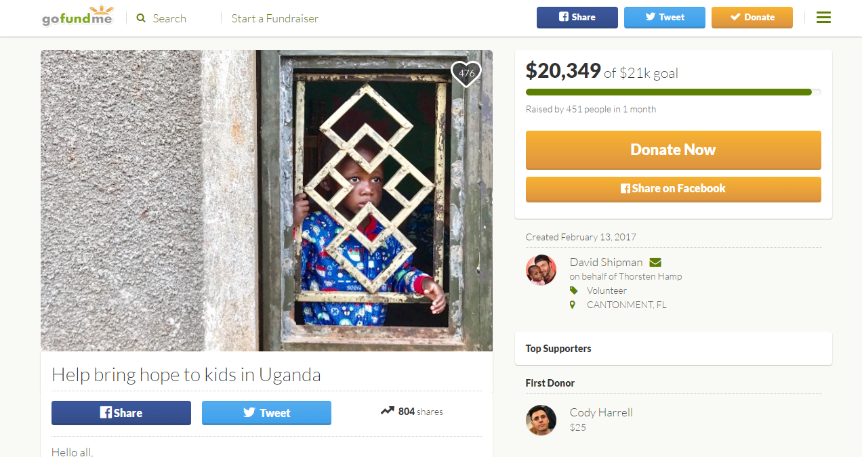

Slide 11
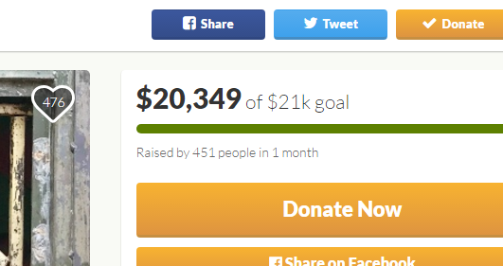

Slide 12


Slide 13
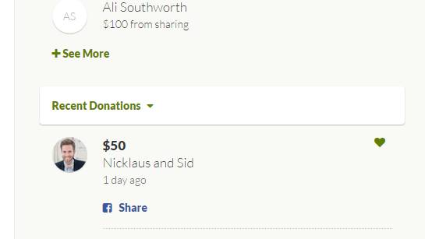

Slide 14
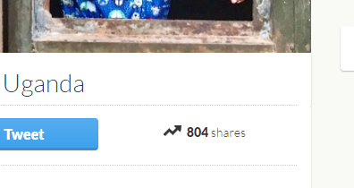

Slide 15
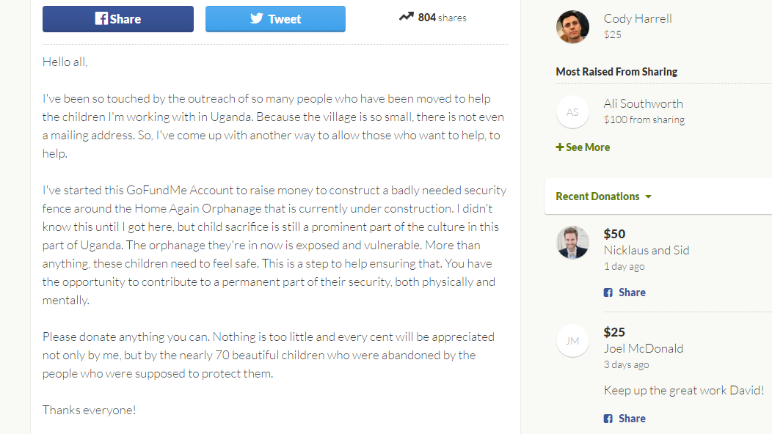

Slide 16
Hypotheses Predictors
Category (Medical, Sports, Education, Newlyweds)
Season (Holiday Season)
Financial Goal (Large or Small)
Social Media Shares
Sentiment (Positive or Negative)
Notes:
- Category (e.g. )

Slide 17



Data
Notes:
Collecting: Web scraping (Beautiful-soup & Requests)
Cleaning: Excel and Python (Vadersentiment)
Implementing methods: R

Slide 18
Methods
Kaplan Meier
Accelerated Failure Time (AFT) Models
Cox PH (Proportional Hazards) Model

Slide 19
Kaplan Meier
Non Parametric
Works only on Categorical Variables
Survival Curve that accounts for Right Censoring
Survival Time
Censoring
Notes:
Familiar with Normal Curve?
Time to failure
Censoring: Incomplete data (at the time of data collection). Lower bound.

Slide 20
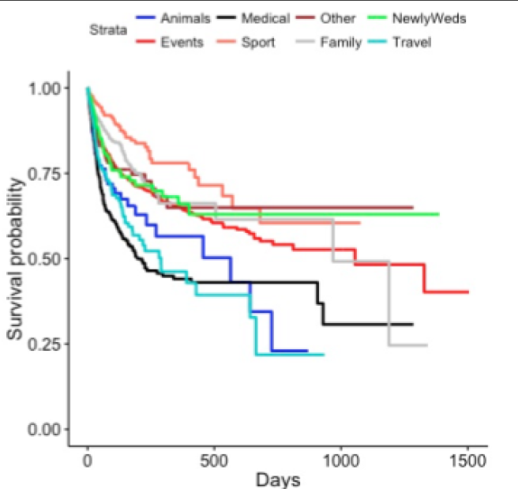
Kaplan Meier: gofundme data
Category

Slide 21
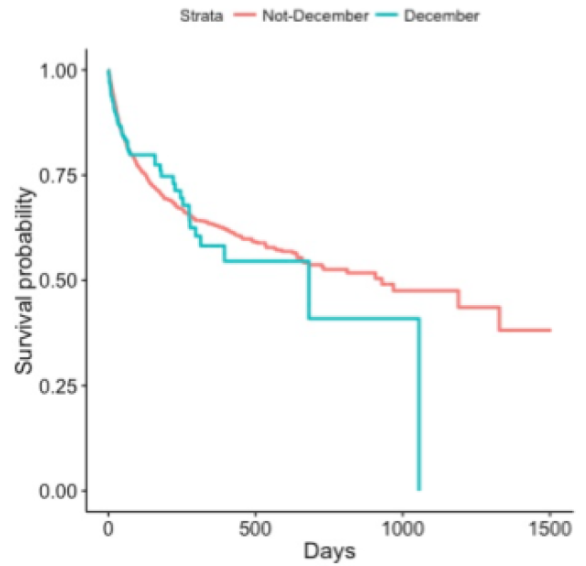
Kaplan Meier: gofundme data
Season

Slide 22
Accelerated failure time (AFT)
Parametric (Exponential, Normal, Weibull & Lognormal)
Works on both categorical and non-categorical covariates
C_{i} < 0 : Short Survival
Notes:
- We did all 4 of them. Weibull was the best

Slide 23
AFT Model: gofundme data
Result Summary
Category | ☺ | Significant
Season | х | Insignificant
Financial Goal | ☺ | Significant
Social Media Shares | ☺ | Significant
Sentiment (Mostly Positive) | ☺ | Significant

Slide 24
Sentiment: gofundme data
Significance does not always hold
Further work: Linguistic Inquiry and Word Count (LIWC)
Negative sentiment may also show how dire the situation is.

Slide 25
Cox PH (Proportional hazards)
Semi parametric
What is the effect of a covariate on the hazard rate?
Hazard Rate: Rate of failure.
Notes:
Baseline is the Kaplan Meier
Coefficients are linear

Slide 26
Cox Ph: Gofundme
Result Summary
Category | ☺ | Insignificant
Season | ☺ | Insignificant
*Financial Goal | x | Time Varying
Social Media Shares | ☺ | Significant
Sentiment (Mostly Positive) | ☺ | Significant
Notes:
The effect of financial goal is always negative i.e. having a larger financial goal makes it less likely that the project will be funded.
But, this is particularly true early on in a campaign.

Slide 27
Conclusion
Category – Medical is best
Season – No Correlation
Financial Goal – A small goal is ideal
Social Media – The more shares, the better
Sentiment – Positive sentiment is good for you
Notes:
- Category (e.g. )

Slide 28
Notes:
Visit gofundme.com

Slide 29
Acknowledgements
Prof. Victor Addona
Muath Ibaid
Family, Friends & Loved Ones

Slide 30
Thank you

Slide 31
Questions, comments, concerns?

Slide 33
AFT Model Comparison
Akaike Information Criterion (AIC) – a measure of the relative quality of statistical models given a set of data.
AIC = 2p – 2L
The lower the AIC, the better!
Notes:
- delete

Slide 34
Cox PH Assumption
Effect of a covariate is constant over time
Cox PH Assumption Tests
Complementary log-log plots
Schoenfeld Residuals
Defined at each failure time
S = x – E(x)
A horizontal line is expected if the Cox PH assumption is not violated
Notes:
Baseline is the Kaplan Meier
Coefficients are linear
- delete

Slide 35
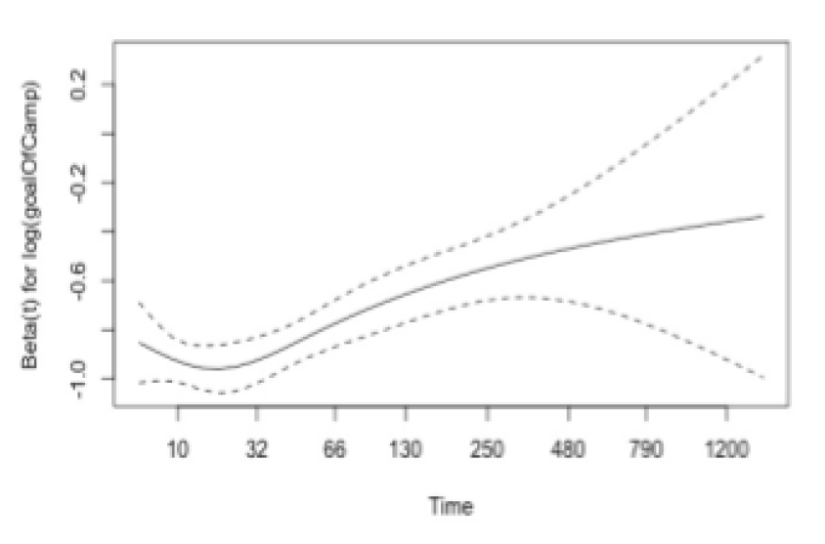
Cox PH Assumption: Gofundme Data
goal of campaign: the only covariate that violates the COX PH assumption
Solution: Stratify the data by goal of campaign
Notes:
Baseline is the Kaplan Meier
Coefficients are linear
- delete

